Slide 1
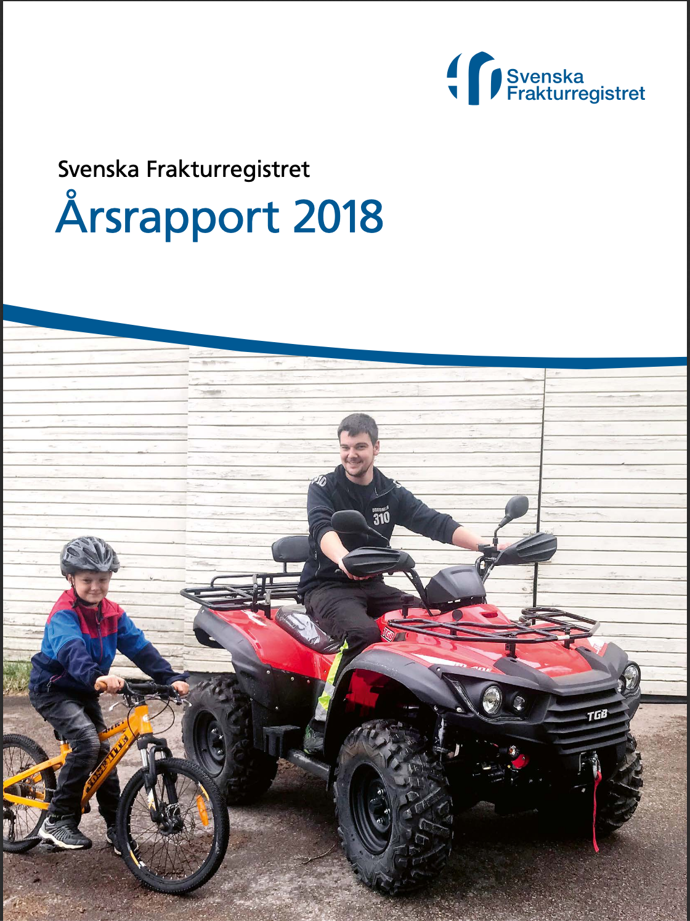
Register Nested Trials Experience from the Swedish Fracture Register
Co Director
Swedish Fracture Register
Olof Wolf
Department of Orthopaedics
Uppsala University Hospital, Sweden

Slide 2
Swedish Fracture Register
Started 2011
fully developed 2015
All fracture types in one nationwide fracture register
Surgical and non-surgical treatment
100% coverage since 2021
Increasing completeness >65% for all fractures
>80 for hip fractures

Slide 3
Swedish Fracture Register
Web based registration by surgeons
Fractures classification AO/OTA
Injury mechanism and treatment registered
Classification of pathological, periprosthetic, open fractures

Slide 4
Demonstration of the
Swedish Fracture Register

Slide 5
Web based

Slide 6
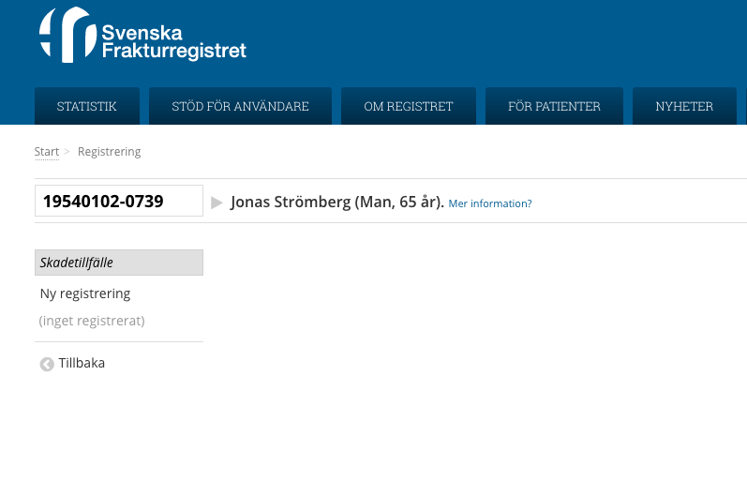
Personal identity number is the key
Name in real time from the Swedish Population Register
Possible to link to other registers

Slide 7
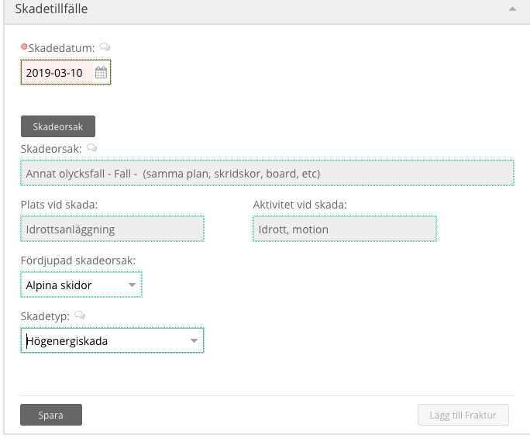
Injury mechanism
Date
Cause
Location
Low/high energy

Slide 8
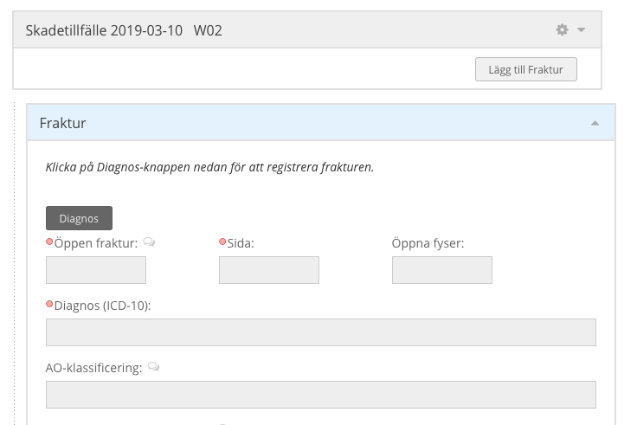
Fracture characteristics

Slide 9
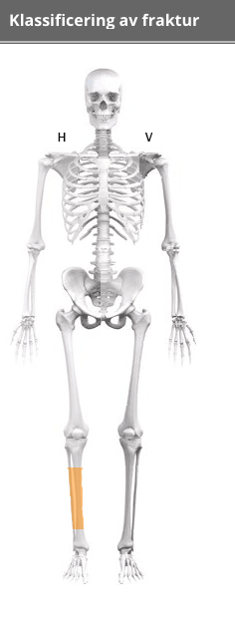
Fracture classification

Slide 10
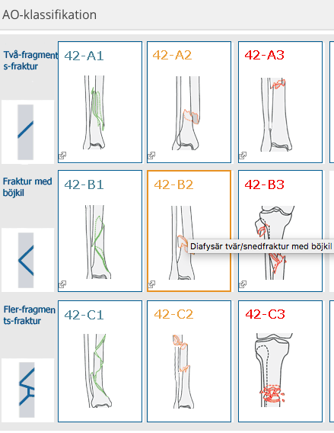

Slide 11
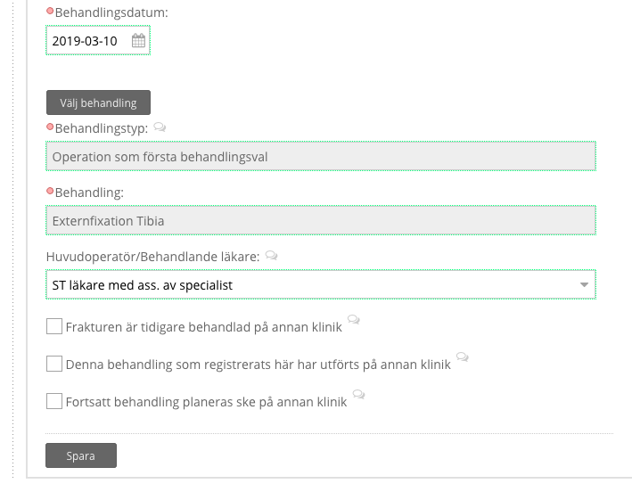
Treatment details
Type
Method
Surgeon level

Slide 12
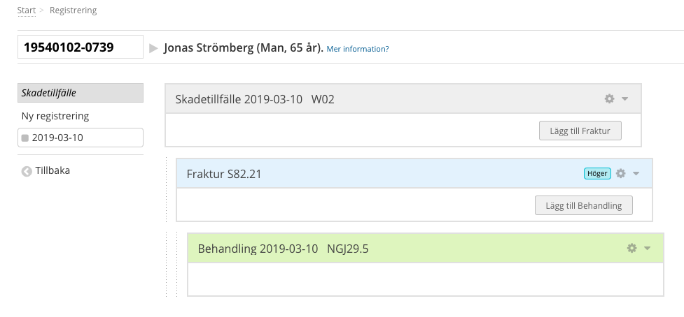
Full primary registration
External fixation
Subsequent reoperation added to initial fracture
PROM (EQ5D and SMFA) pre-injury and 1-year

Slide 13
> 50 Publications

Slide 14
What kind of research is good research?
Multicenter RCTs
100 patients, eg DASH score
Pragmatic multicenter RCTs
ProFHER: 1250 screened, 250 included
Register studies
1,000?
10,000?
… 100,000?
Why not combine them all?

Slide 15
Registerbased RCT
Use the Register to find the patients
Inclusion criteria defined
External validity
Construct a study platform
Screening/Eligibility
Randomisation
Outcome – no follow-up (easiest)
Retrieve from SFR or other registers
Mortality?
Reoperations?

Slide 16
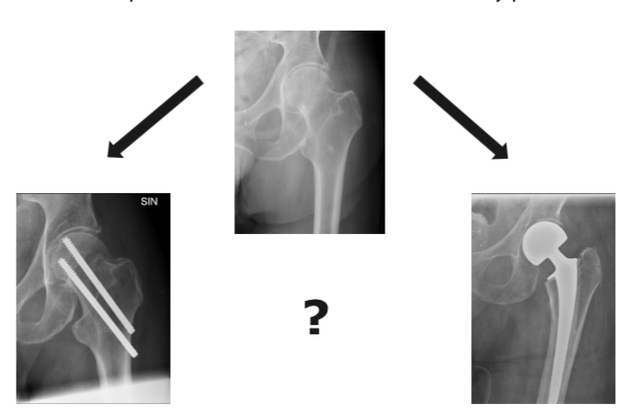
HIPSTHER Hip Screws or (Total) Hip Replacement for undisplaced femoral neck fractures in elderly patients

Slide 17
Primary Outcome
Composite variable comprising
Reoperation rate & Mortality

Slide 18
Hipsther set up
No follow up visits!
Mortality and reoperations registered in the SFR
Reoperations linked with
The Swedish Hip Arthroplasty Register
The National Patient Register
Patient reported outcome in SFR
Notes:
Utfallsdata hämtas från SFR och andra register

Slide 19
Hipsther Study Platform

Slide 20
Injury Mechanism

Slide 21
Fracture Characteristics

Slide 22
Fracture Characteristics

Slide 23
Inclusion criteria recognised by platform
> 75 years
uFNF
< 3 days
The patient fulfills the inclusion criteria for the Hipsther study?
Do you want to screen the patient now?

Slide 24
Screening questions
Has the patient already received treatment for the fracture?
Is the patient fit for both procedures?
Does the department have the resources for both procedures?
Has the patient given informed consent?

Slide 25
Patient included and randomised
Participating sites can choose:
Prosthesis (make, fixation, type Hemi or Total)
Osteosynthesis (screws/nails, 2-3)

Slide 26
Hipsther so far. 30 sites. 877 patients

Slide 27
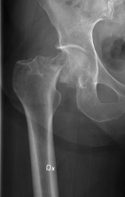
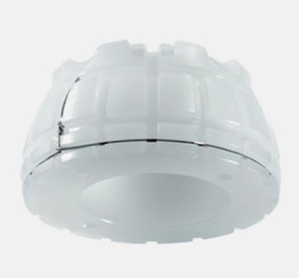
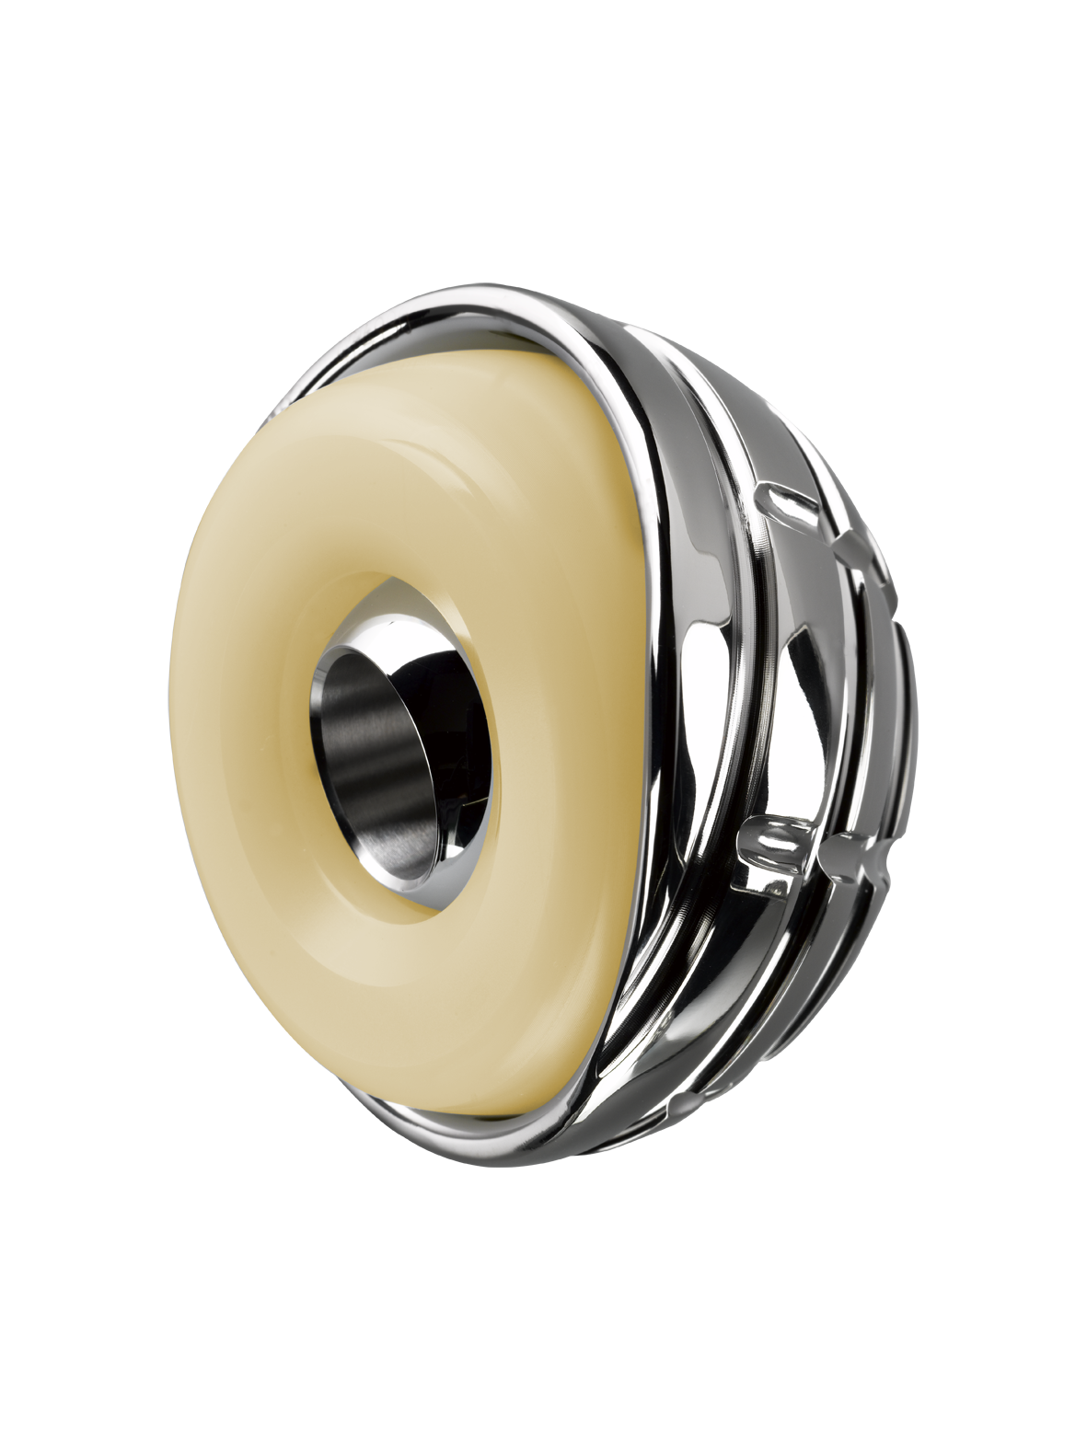
Duality-study
PI Prof N.P. Hailer
Inclusion:
Patient ≥65 years with displaced FNF
Total Hip replacement
?
Randomization:
Standard Cup or Dual Mobility Cup

Slide 28
Duality 1082 /1600 patients

Slide 29
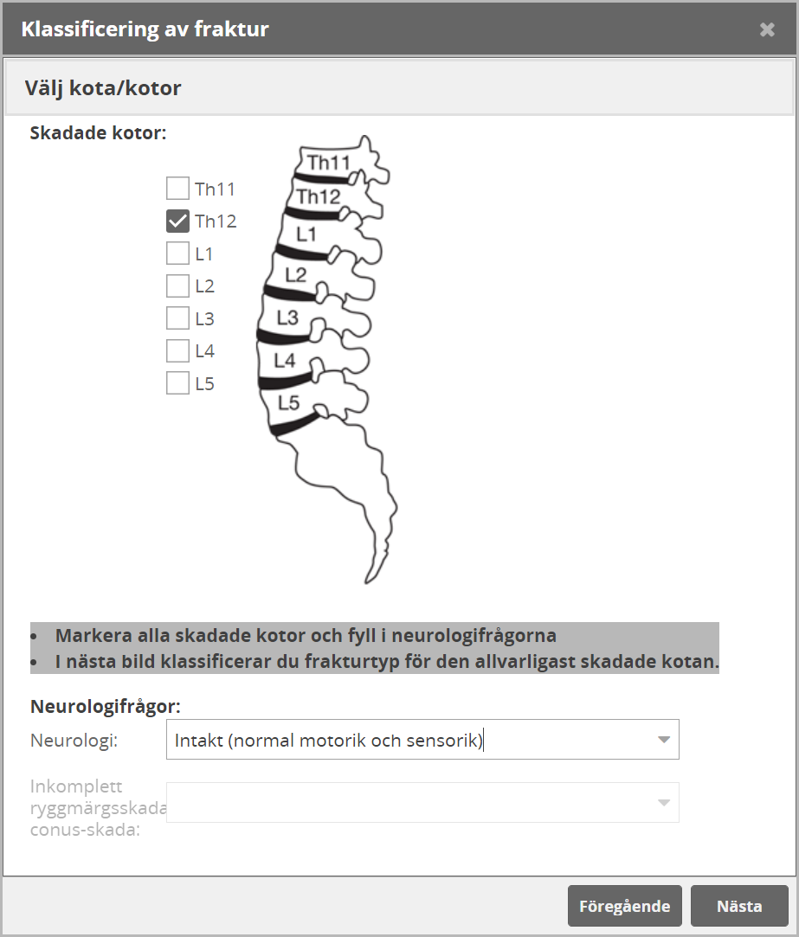
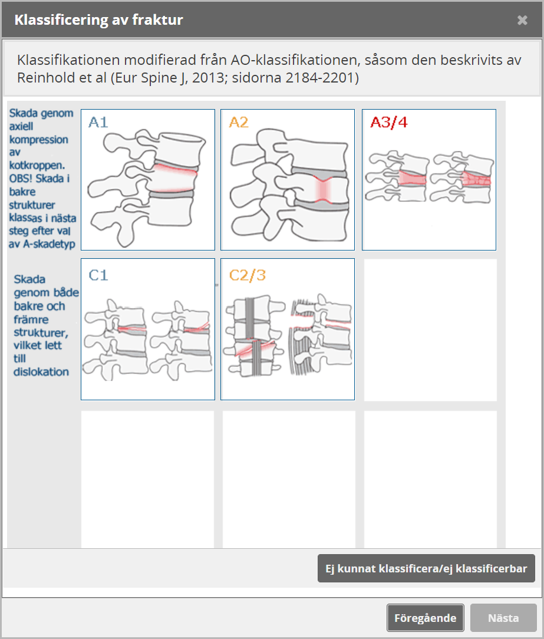
Thoracolumbar burst fractures
Non operative vs operative treatment
79/202 patients randomized
PI Prof P. Gerdhem

Slide 30
Experiences rRCTs in the SFR
Personal identity number enables linking registers for outcome
No research unit needed at local hospital
small regional – University Hospitals
60% hospitals active in Hipsther, 40% in Duality
Only add-on is consent and preoperative registration, screening and randomzation
National funding to Hipsther, Duality and SunBurst

Slide 31
Problems
Solutions?
Register maintenance
study platform down
Study site activity
recurrent presentations/information
no local exclusion criteria
Inclusion and consent
hip fractures? vs elective?
Start-up meeting/information
study platform only active in study sites
Inclusion rate
monthly feedback
Recurrent study meetings
local investigators
Local monitoring

Slide 32
Future perspective
Study Platform works
Randomisation
Preoperative (blocks, nutrition)
Postoperative regime (weight bearing, pain medication, anticoagulants, antiresorptive medication)
Olof.wolf@surgsci.uu.se

