Slide 1
Age, sex, primary tumor type and site are associated with mortality after pathological fractures An observational study of 1,453 patients from the Swedish Fracture Register
Johan Wänman, Sonja Kjartansdóttir, Olof Wolf, Jonas Sundkvist, David Wennergren and Sebastian Mukka
Ass Professor, Department of Surgical Sciences/ Orthopaedics, Uppsala University, Sweden
Consultant Orthopaedic Trauma Surgeon, Uppsala University Hospital, Sweden
Co-Director, Swedish Fracture Register

Slide 2
Background
Life expectancy for cancer patients has improved
Metastatic long bone fractures are associated with poor functional outcomes and survival
The reconstruction must be durable in relation to the estimated life expectancy

Slide 3
Aim
This study aimed to evaluate survival after pathological fracture in relation to
age
sex
primary tumor
site of the pathological fractures

Slide 4
Materials and Methods
Observational register study from the Swedish Fracture Register (SFR)
Patient selection
All Pathological fractures (ICD code M84.4) 2014-2021
Primary tumor as breast, prostate, kidney, lung, myeloma, other or unknown.
1577 pathological fractures
124 were excluded due to multiple pathological fractures in the same patient.

Slide 5
Materials and Methods 2
Outcome variables
Age
Sex
Primary tumor type
Site of the pathological fracture
Treatment
Mortality
Statistics
The log-rank test and the Cox proportional hazards were used for survival analysis

Slide 6
Results
1453 patients; 52% men
Median age 73 years (18-100)
Operative treatment 66%
Primary tumor at time of fracture:
Unknown 21%
Prostate 20%
Breast 15%
Myeloma 13%
Lung 9%
Kidney 5%

Slide 7
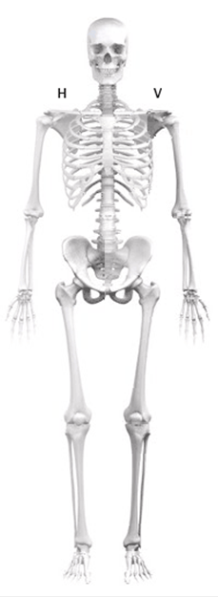
Distribution and pattern of tumor seed
Upper extremity 33%
Spine 9%
Upper extremity
50% of myeloma
46% of kidney cancer
Spine
12% of unknown primary
Pelvis 5%
Lower extremity 53%
Pelvis
8% of prostate cancer
Lower extremity
63% of breast cancer
60% of prostate cancer
56% of lung cancer

Slide 8
Survival after pathological fracture
The median survival was 213 days (95% CI 185-241)
Lung cancer shortest (78 days)
Myeloma longest (432 days)
Mortality was 12% at 30 days and 60% at 1 year
Age, sex (male) , primary tumor (lung cancer) and site of the pathological fractures (extremities) were associated with higher mortality.

Slide 9
Discussion
Tumors seed differently to bones and cause different types of fractures.
Unknown primary tumor is common at time of pathological fracture.
The primary tumor is a major predictor of survival
The independent prognostic value of pathological fracture site has never been demonstrated
The poor prognosis calls for careful consideration of the potential benefits of surgical treatment

Slide 10
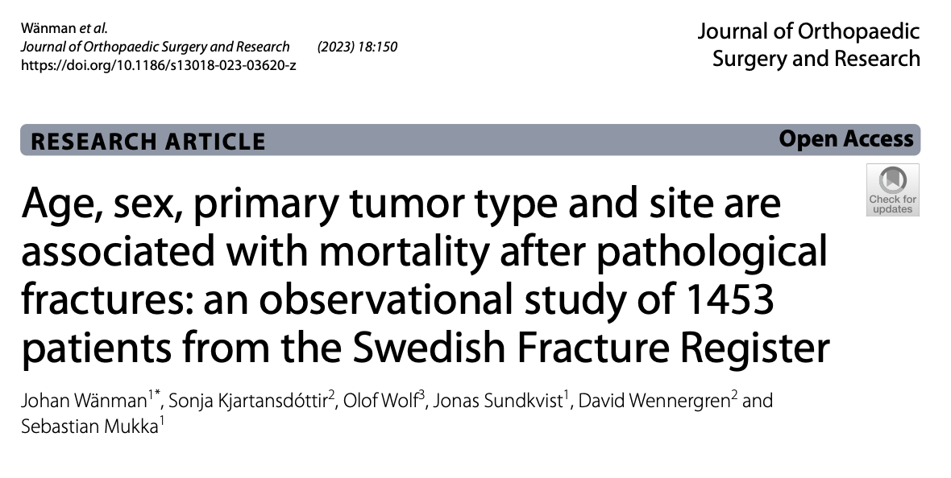
Conclusion
Survival affected by:
Age
Sex
Primary tumor site
Location of pathological fractures
Survival time is short and correlated to primary tumors.
Lung cancer is the strongest negative predictor of survival.

