Slide 1
Hip Screws Or Hip Replacement For Undisplaced Femoral Neck Fractures In The Elderly An Observational Register Study Of 3,909 Patients
Olof Wolf, Tatevik Ghukasyan Lakic, Johan Ljungdahl, Jonas Sundkvist, Michael Möller, Cecilia Rogmark, Sebastian Mukka, Nils P. Hailer
Ass Professor, Department of Surgical Sciences/ Orthopaedics, Uppsala University, Sweden
Consultant Orthopaedic Trauma Surgeon, Uppsala University Hospital, Sweden
Co-Director, Swedish Fracture Register

Slide 2
Undisplaced femoral neck fractures
Previous treatment regime
Internal fixation (IF) 2-3 cannulated screws or pins
Complications
Reoperations 8-27%
Fixation failure
Nonunion
Avascular necrosis
Implant-related fracture
Removal of implants
(Conn 2004; Palm 2009; Gjertsen 2011; Rogmark 2009, Sjöholm 2021)

Slide 3
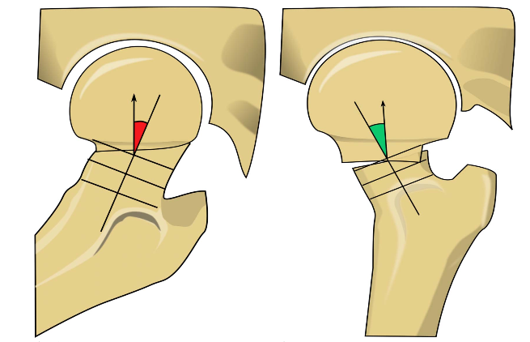
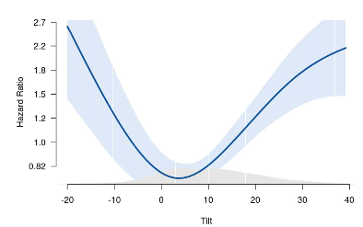
Change in treatment?
Preoperative tilt associated with failure?
Arthroplasty for majority of uFNF in Australia and NZ
RCT:
No difference in hip function or mortality
Hemiarthroplasty – fewer reoperations, improved mobility
(Sjöholm, JBJS, 2021; Dolatowski, JBJS, 2019)

Slide 4
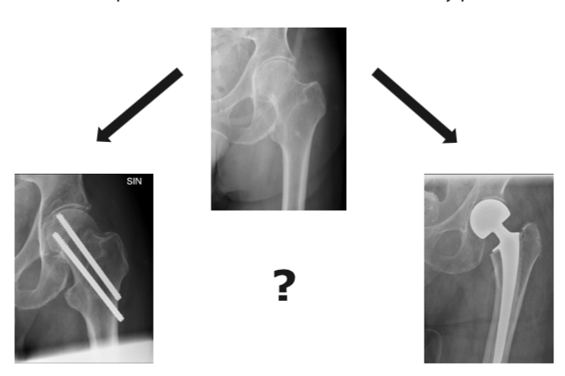
Aims
Primary
Reoperation free survival for IF vs Arthroplasty
Composite variable (mortality or reoperation)
Secondary
Mortality
Reoperation rate

Slide 5
Patients and methods
Patients ≥75 years with uFNF, 2011-2018,
IF or Arthroplasty
Retrieved from Swedish Fracture Register
Linked with
Swedish Arthroplasty Register (Secondary treatment with arthroplasty)
National Patient Register (Comorbidity)
Statistical analysis
Reoperation free survival (Restricted Mean Survival Time)
Adjusted for Age, Sex and Comorbidity
Cumulative event rates (Kaplan-Meier plots)

Slide 6
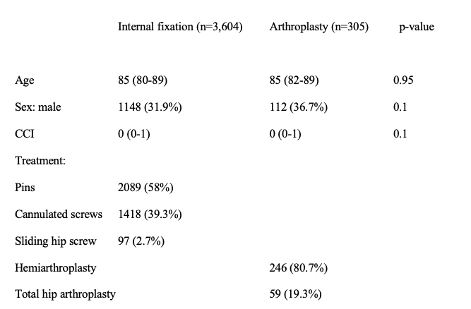
Characterstics of study population

Slide 7
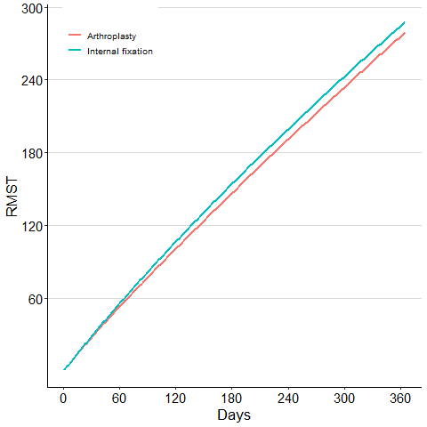
No difference in Reoperation free survival up to 1 year
At 1 year
8.4 days (95% CI -8 – 25)
No difference when adjusted for age, sex and comorbidity
6.7 days (95% CI -9 – 22)

Slide 8
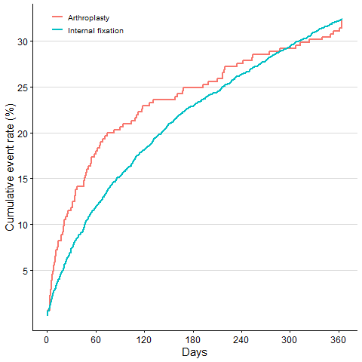
Cumulative mortality and reoperation rates
Combined composite variable
IF vs Arthroplasty at 1 year
32.4% vs 32.1%

Slide 9
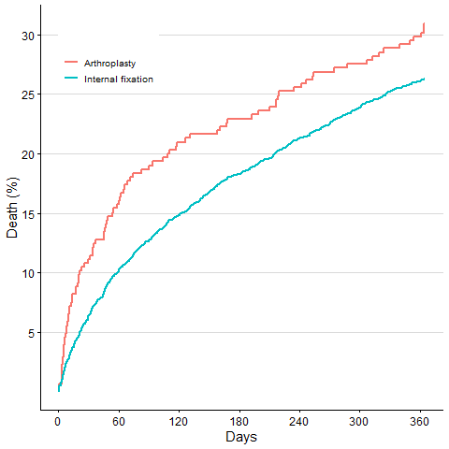
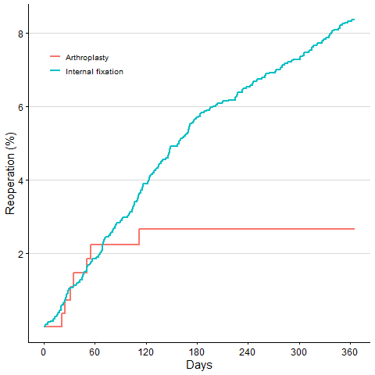
Cumulative mortality and reoperation rates
Mortality
Reoperation
ORIF vs arthroplasty
7 day mortality
2.4% vs 4.9%
1 year mortality
26.3% vs 30.8%
1 year Reoperation
7.1% vs 2.3%

Slide 10
Discussion
Higher mortality?
Older patients?
Observational study vs RCT?
Reoperation rates lower?
Compared to previous studies? 1 year F/U – more failures 2-5 years for IF
(Dolatowski, JBJS 2019)

Slide 11
Conclusion
No difference in reoperation-free survival in patients ≥75 year with uFNF treated with IF or Arthroplasty up to 1 year
Composite variable (mortality or reoperation)
Different risks – mortality vs reoperation
3 ongoing RCTs:
Hipsther (Swe), Sense (DK) and Fruity (UK)
The author declares that the research for and communication of this independent body of work does not constitute any financial or other conflict of interest

